Slide 1
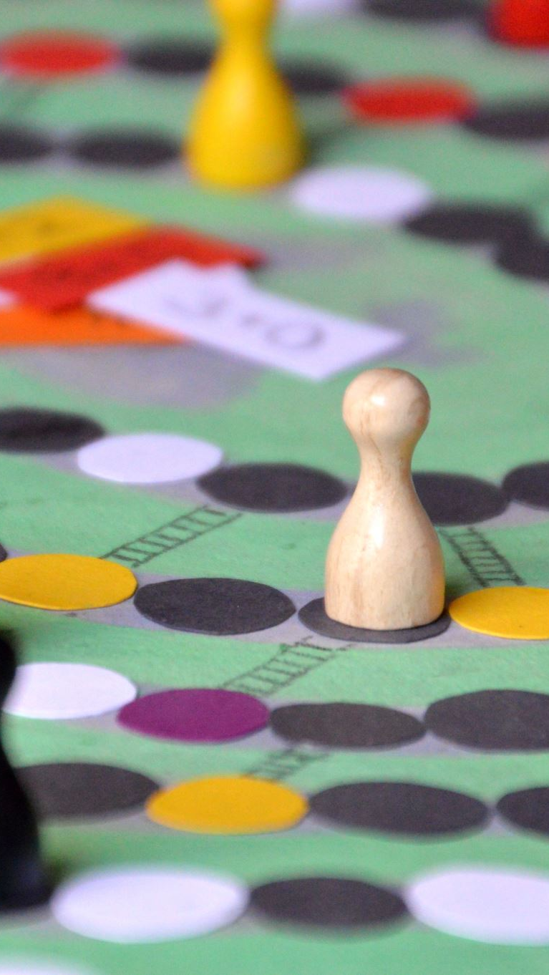
Story and Video Games
Intro, components and mapping

Slide 2
Story
The telling of a series of events
All Video Games have stories
Passive vs Active Participation
What tools to video games have at their disposal to tell stories?
What common problems do we encounter telling stories in video games?

Slide 3

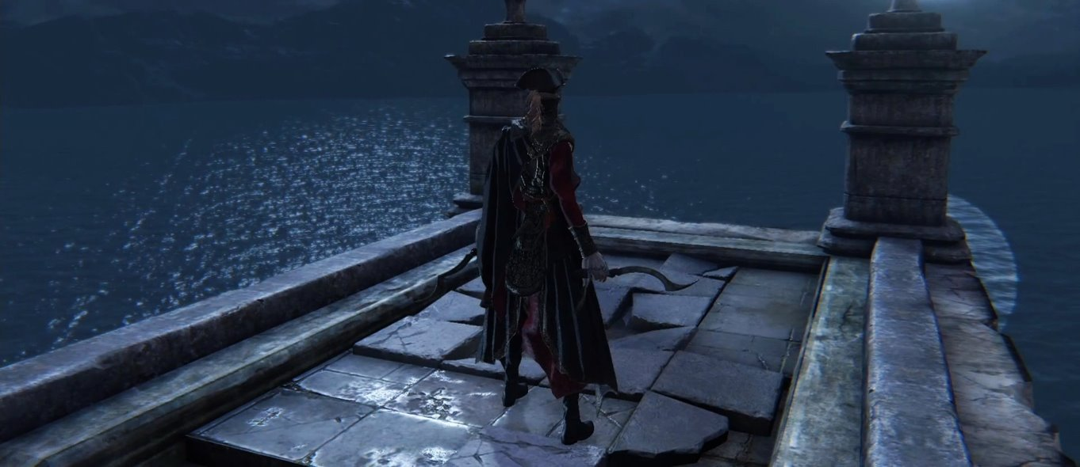
Stories are inherent in most videogames
Complexity (or lack of) does not diminish the story in a game

Slide 4
What tools do video games have at their disposal to tell stories?

Slide 5
What common problems do we encounter telling stories in video games?

Slide 6
Components of a story
Setting
Plot
Character
Conflict
Theme

Slide 7
Setting
When and where the story takes place
Sets the atmosphere and environment the story takes place
Often linked to "world building" in interactive media
Can be used to shape things like characters, relationships, politics, values, conflicts etc

Slide 8
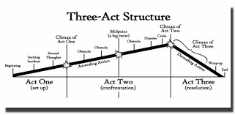
Plot
The events that make up the story
Often follow the three-act structure
Can be split into five parts
Exposition
Rising Action
Climax
Falling Action
Resolution
Perspective and order of the plots are influenced by the narrative

Slide 9
Character
The agents in the story
Protagonist
Antagonist
Dynamic
Static
Round
Flat

Slide 10
Conflict
Things that prevent characters from achieving a goal
Can be internal or external (often the external is a metaphor for the internal)
Internal = Person vs themselves
External
Person vs person
Person vs Nature
Person vs Society
Growth is typically a direct result of conflict

Slide 11
Theme
What the story is about
The "messages" or "ideas" the stories portray
In videogames often the gameplay generates meaning more than the themes of the story

Slide 12
Mapping Stories to mechanics
"Stories set up a promise that mechanics deliver on"
Often theirs a disconnect between stories and mechanics of a game
The story in Mario is about a plumber saving a princess, the game is actually "about" timing jumps

Slide 13
Mapping Stories to mechanics
What agency does the player have over the characters?
What information does the player know vs what the character knows?
When the story of the characters progress, does the game progress or mechanics change?
Does the plot points in the story match to the flow of the game?
Do the consequences of the story have any weight when translated to gameplay?
Do the themes the story tries to explore become apparent when playing the game?
Are you using video games to tell a story or trying to squeeze a story into a videogame

